Slide 1


Machine Learning
Frameworks
Presented by 王旭刚

Slide 2
C
O
N
T
E
N
T
S
1
Machine Learning
2
Frameworks
3
Comparison
4
Application

Slide 3

01
Machine Learning

Slide 4
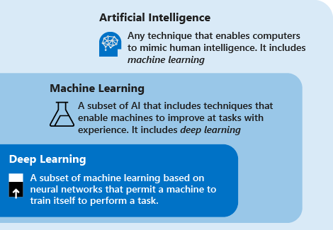



1
Machine Learning
Machine Learning
Understanding and Building method that “learn”

Slide 5
02
Frameworks

Slide 6
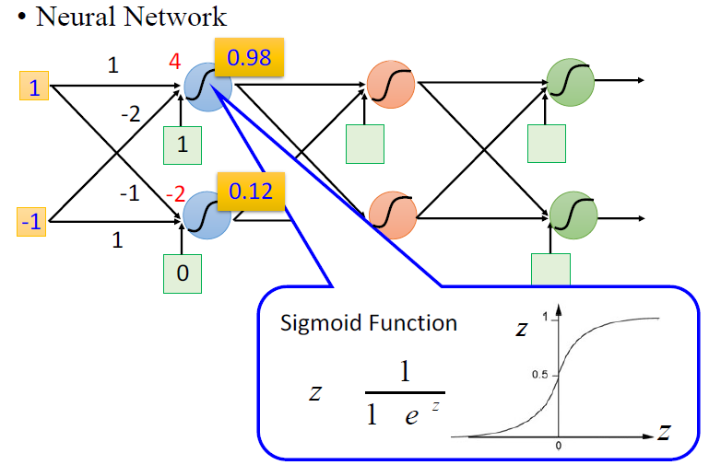
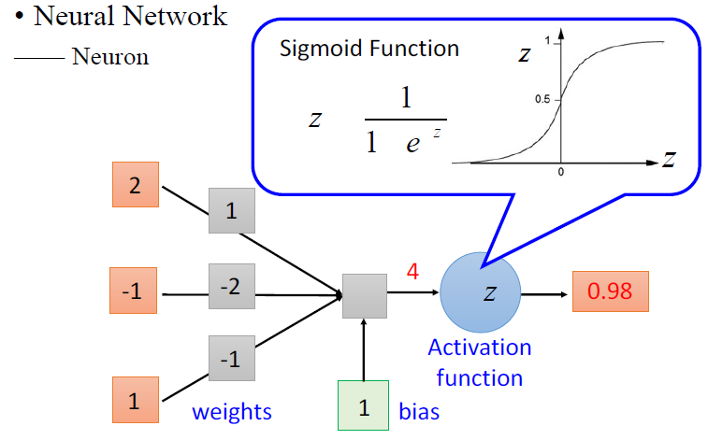
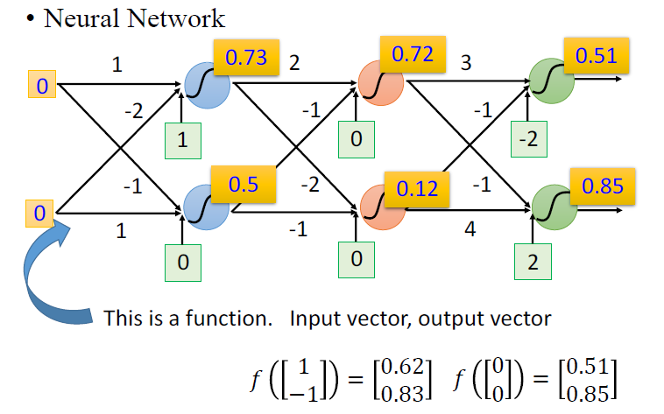
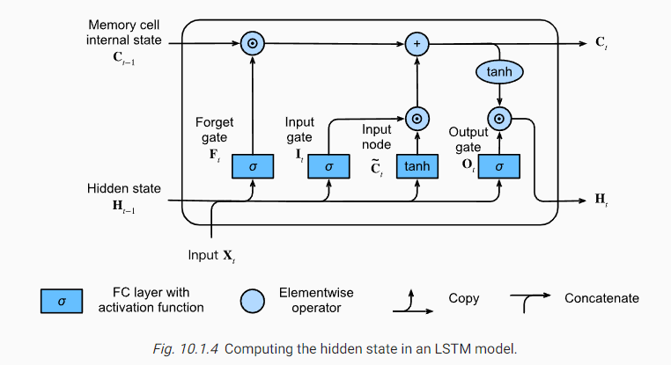
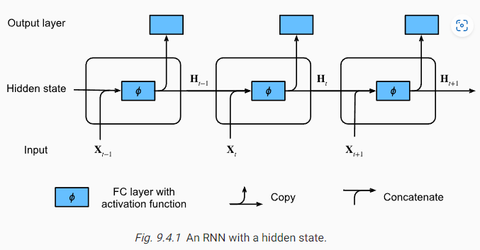
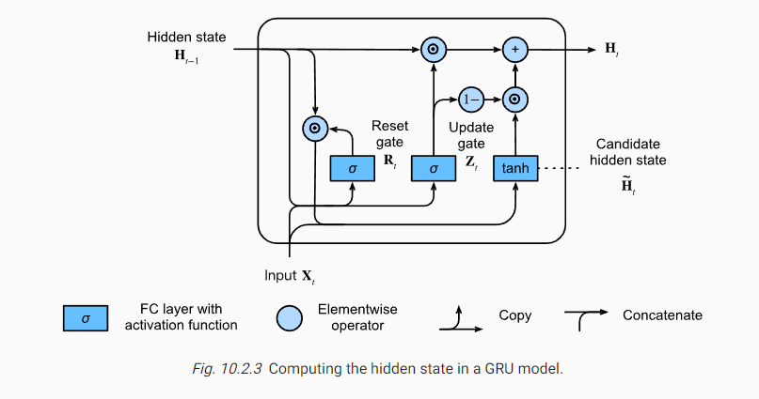
2
Frameworks

Slide 7
2
Frameworks
Machine Learning Frameworks
Simplify the ML algorithms
It can be any tool, interface or library
There are many ML frameworks geared at different purposes

Slide 8








2
Frameworks

Slide 9
2
Frameworks

Slide 10
2
Frameworks

Slide 11
03
Comparison

Slide 12

3
Comparison

Slide 13

3
Comparison

Slide 14
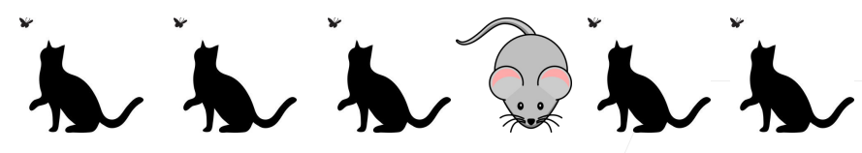
3
Comparison
Gated Recurrent Units
Mechanism to focus
Mechanism to forget
: Update gate
: Reset gate

Slide 15
3
Comparison

Slide 16
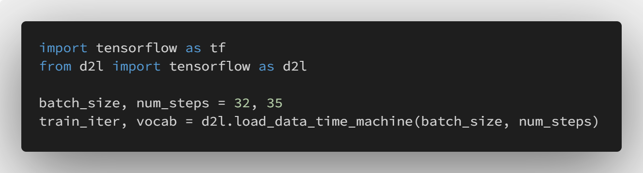
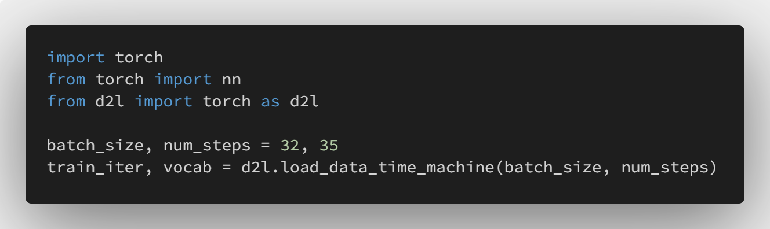
3
Comparison

Slide 17
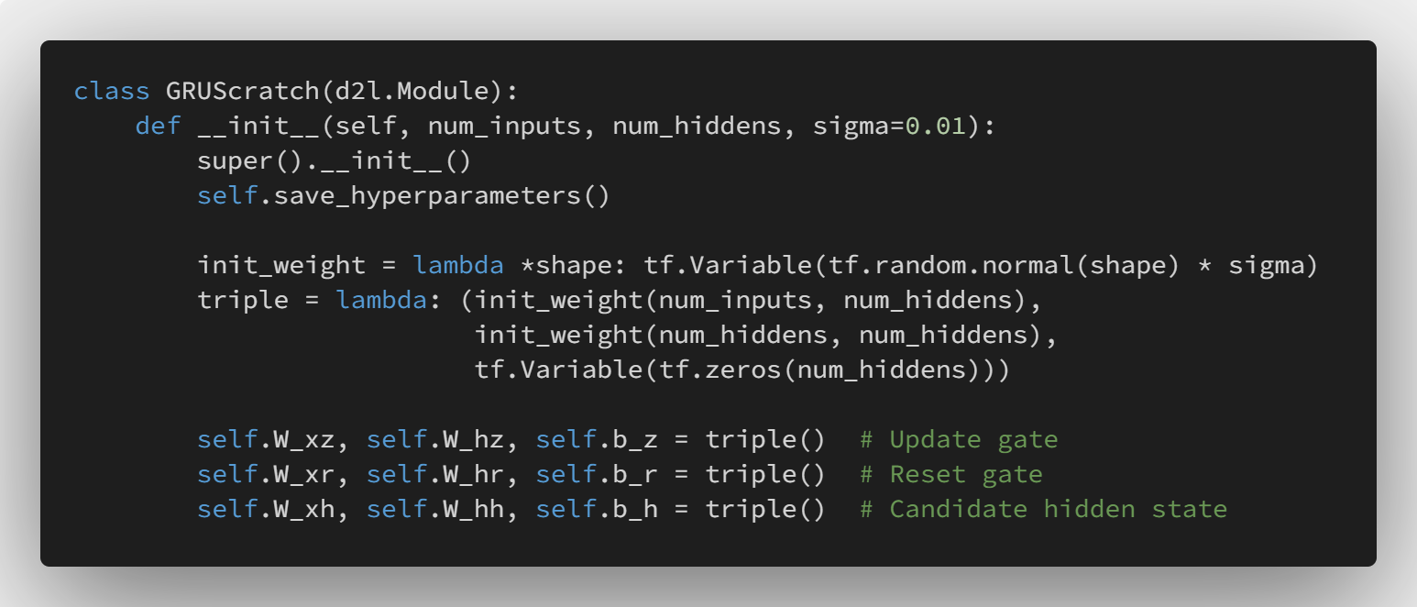
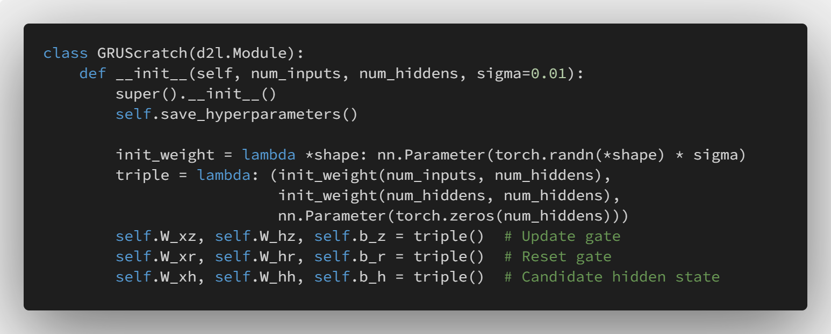
3
Comparison

Slide 18
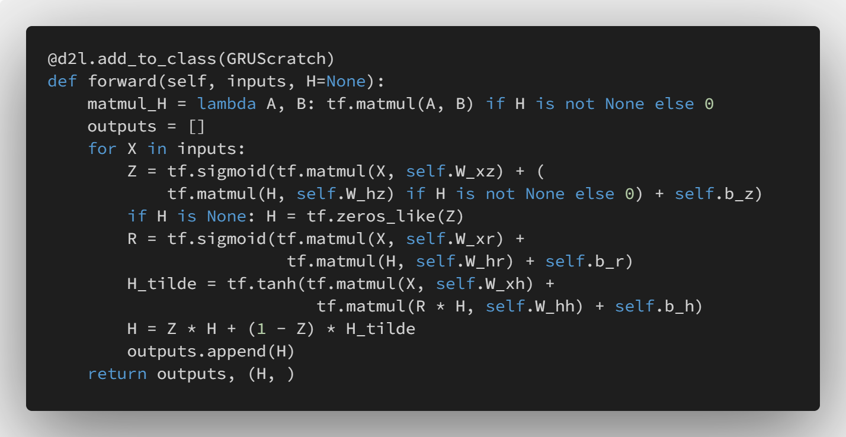
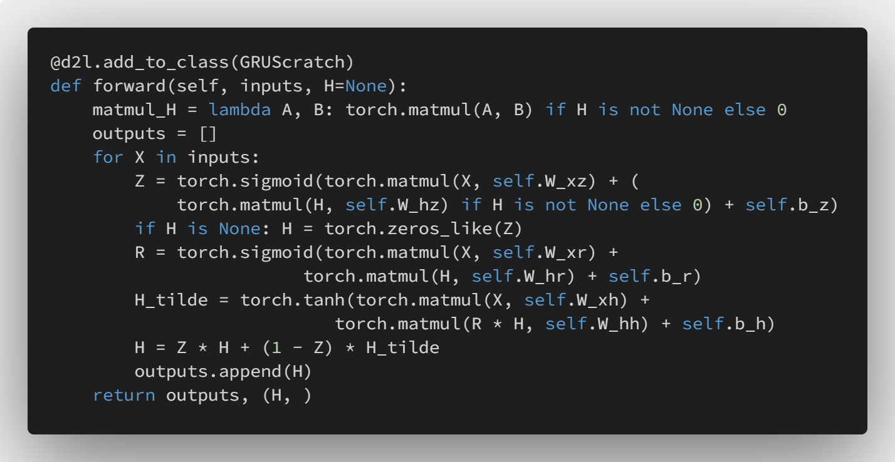
3
Comparison

Slide 19
3
Comparison
 | PyTorch | TensorFlow
Working Cycle | short | long
PreTrained Model |  | better
Tutorials |  | better
Functions |  | better
Visualization |  | better
Deploying |  | better
Data parallelism | better
Easy to start | better
Object-oriented | better

Slide 20


3
Comparison

Slide 21
04
Application

Slide 22
Thank you for your attention

